Slide 1
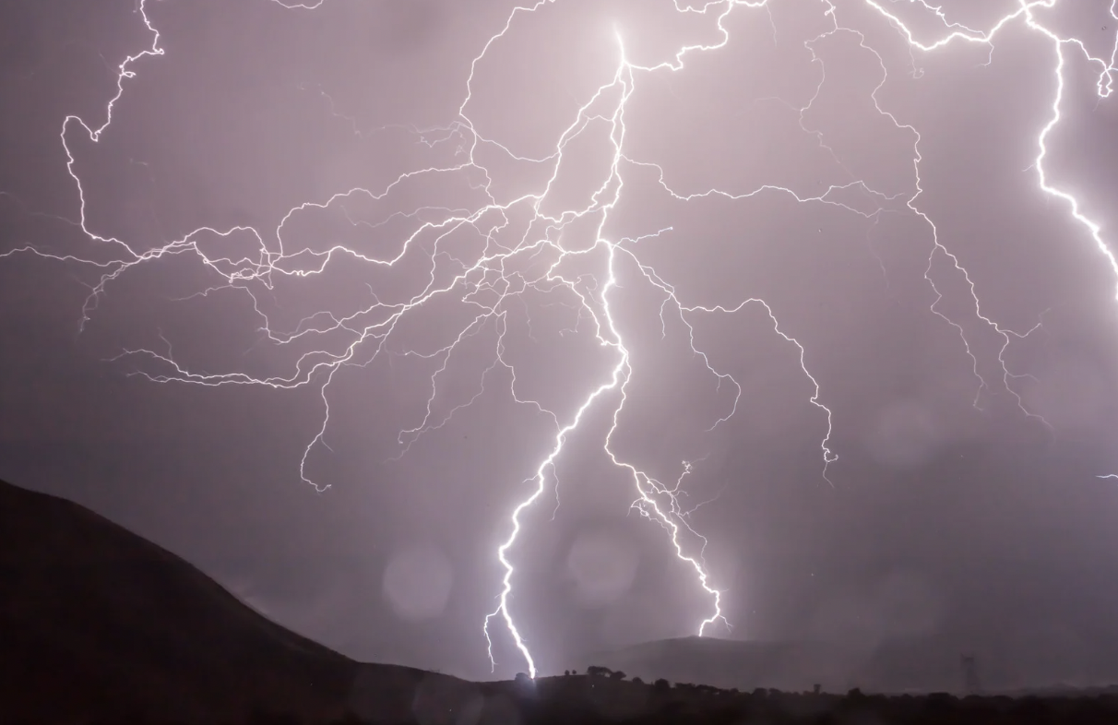
The Post Office Limited treatment and abuse of Sub Post Masters (SPM) - A perfect storm NIFA Annual Conference 21st. November 2024
BY Dr KAY LINNELL FCA MBA FCI Arb CFE FEWI

Slide 2
CONTRACTS
Dept. Business and Trade
Post Office Ltd (POL)
SPM and Crown Office
BY Dr KAY LINNELL FCA MBA FCI Arb CFE FEWI

Slide 3
POL STRUCTURE
SPM Contract
Ownership of documents
Communication and IT updates
Manuals and network support
POL Management structure
BY Dr KAY LINNELL FCA MBA FCI Arb CFE FEWI

Slide 4
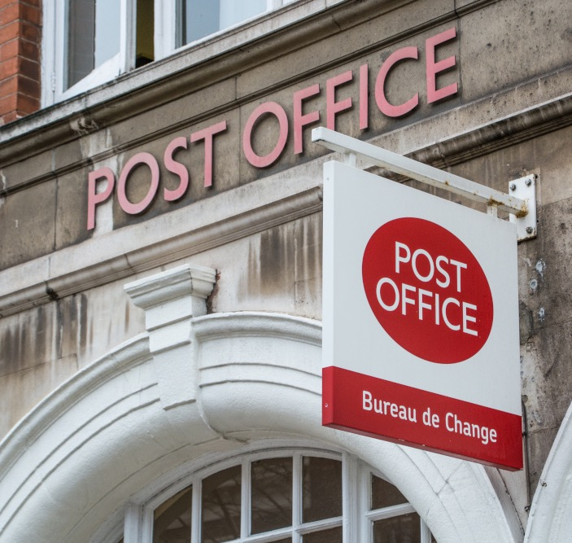
ACCOUNTABILTY
Balancing
Transactions in “mid-air”
Suspense accounts
Third party suppliers
POL Chesterfield HQ
BY Dr KAY LINNELL FCA MBA FCI Arb CFE FEWI

Slide 5
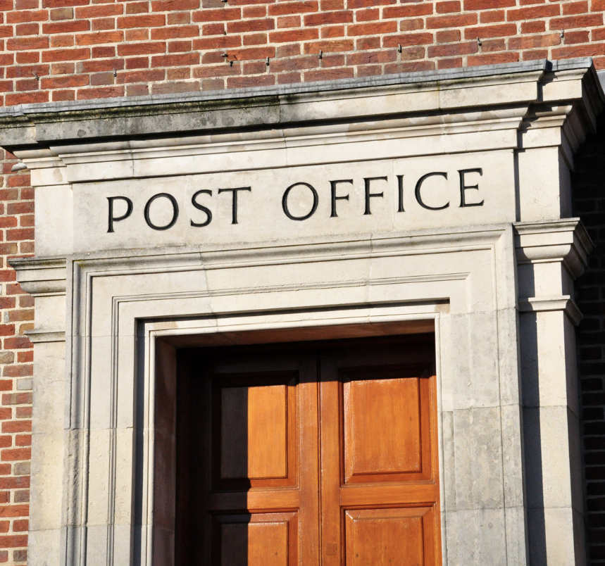
HISTORY
Introduction of Horizon 1999
Initial period to 2004/5
Removal of suspense account
POL use of prosecution power (not CRs)
Attitude to SPM of network managers
Briefing of MPs
BY Dr KAY LINNELL FCA MBA FCI Arb CFE FEWI

Slide 6
SECOND SIGHT
July 2012 Second Sight Support Service Ltd appointed by MPs / JFSA
March 2013 Top issues identified as cause of errors
8 July 2013 Interim Report Issues and POL stopped direct prosecution
31 October 2013 Initial Complaint Review and Mediation Scheme
15 February 2015 Briefing Note to BIS (now DBT)
18 March 2015 SS terminates
27 July 2016 POL instruction to destroy all documents
BY Dr KAY LINNELL FCA MBA FCI Arb CFE FEWI

Slide 7
FINDINGS OF ERRORS / BUGS / DEFECTS IN HORIZON
Communication power failure
Rogue processing (keypad errors)
Missing / duplicated transactions (phone cards / postage labels / GIRO payments / ATMs / Cheques
Training and support issues
Loss of transaction audit trial to SPMs
End of period accounting issues
Contract between POL and SPMs
BY Dr KAY LINNELL FCA MBA FCI Arb CFE FEWI

Slide 8
SS ADVICE TO BIS (DBT) RE SUSPENSE ACCOUNTS
£000s
2010/11 612
2011/12 203
2012/13 234
2013/14 104 Est.
Gross sums released after 3 years from suspense to POL P&L (in SS letter 15/02/2015)
BY Dr KAY LINNELL FCA MBA FCI Arb CFE FEWI

Slide 9
SS CONCLUSIONS
No evidence of SPM personal gain
Horizon errors established
Second Sight access to documents limited
POL cover up from 2012 after break from Royal Mail
POL Brand protection over duty of relational contract to SPM
POL Board included DBT nominated Directors
Fujitsu / POL contract and meetings
Role of HM Governments
BY Dr KAY LINNELL FCA MBA FCI Arb CFE FEWI

Slide 10
FORENSIC ACCOUNTANT'S ROLES
Investigation
Reporting
Expert Evidence
Over-riding obligation to Court/ Tribunal
Professional standards
BY Dr KAY LINNELL FCA MBA FCI Arb CFE FEWI

Slide 11
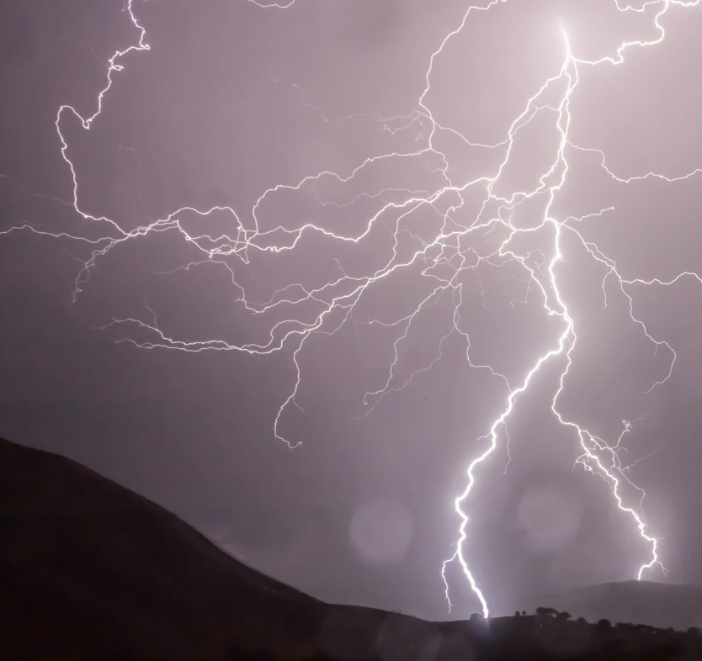
THE PERFECT STORM - FOR AN INVESTIGATOR
Last one-sided instruction
Limited document access
Time pressure to produce report / evidence / conclusions
Restricted access to client / legal team
Exclusion from discussions / no overview of case
BY Dr KAY LINNELL FCA MBA FCI Arb CFE FEWI

Slide 12
A SALUTORY TALE
Jason Coyne (2003) compared to (2019)
BY Dr KAY LINNELL FCA MBA FCI Arb CFE FEWI

Slide 13
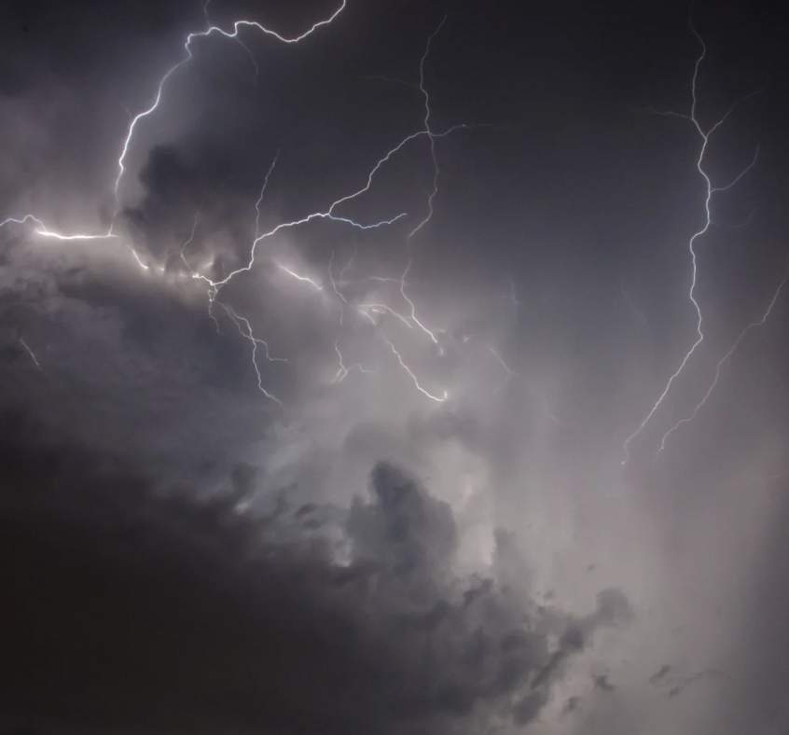
THE PERFECT STORM - FOR AN EXPERT
Independence versus Solicitors wish to win the case
Cost budget and payment for expert fees
Clarity of instruction and expert shopping
Use of short timescales, deadlines and late instructions
Feedback on expert performance and learning outcome of the case.
BY Dr KAY LINNELL FCA MBA FCI Arb CFE FEWI

Slide 14
THE PERFECT STORM - FOR THE GOVERNMENT
Leaving 100% owned trading subsidiary to be managed by DTO / BEIS / BIS / DBT
Failure to take an overview of prosecution of POL
Allowing POL to operate “silo” mentality and mislead Parliament
Appointing the wrong BIS / DBT nominated board directors to POL
Failure to deal with complaints or other reports through MPs
Wrongfully accepting benefits of “stolen SPM” money
Perverting the course of justice.
BY Dr KAY LINNELL FCA MBA FCI Arb CFE FEWI

Slide 15
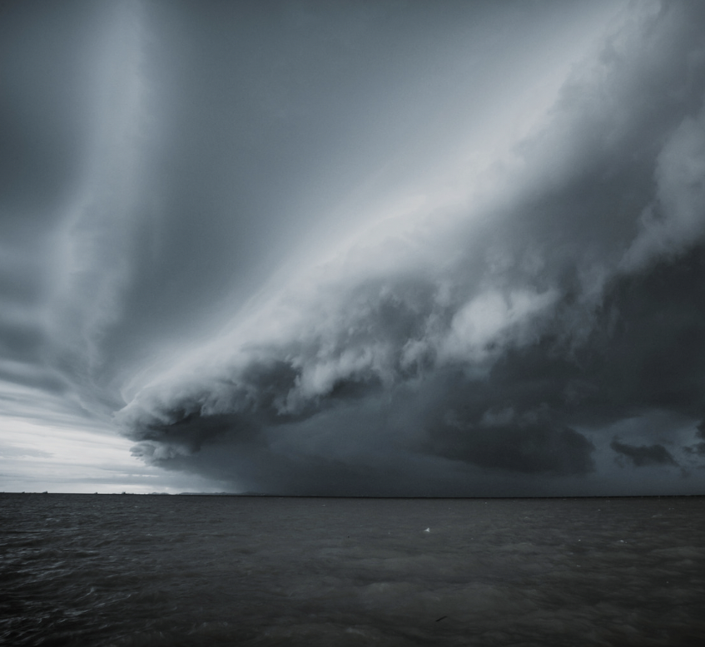
FORENSIC ACCOUNTANTS
Did not assist or listen to SPM
Did not insist on all evidence
Did not attend client and legal meetings during case
Worked in isolation
Gave opinions based on slanted instructions and filtered incomplete late evidence
BY Dr KAY LINNELL FCA MBA FCI Arb CFE FEWI

Slide 16
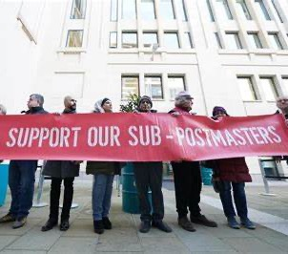
CONSEQUENCES FOR SPMS
Bankruptcy / IVAs
Loss of home, business, managing security, loss of reputation
Loss of reputation
Frustrated and abandoned
Angry and seeking redress and truth
BY Dr KAY LINNELL FCA MBA FCI Arb CFE FEWI

Slide 17
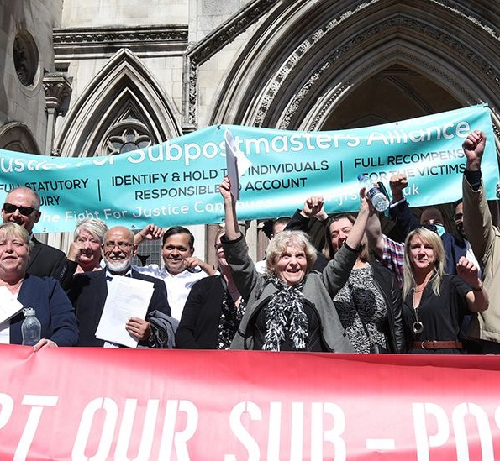
PUBLIC VIEW OF THE PROFESSION
Failure of accountants to assist SPMs
Priority in getting fees paid over duty to client
Failure to use accountancy skills to challenge computer figures
Public accountability and duty
Inertia in reporting wrongs and supporting small client
BY Dr KAY LINNELL FCA MBA FCI Arb CFE FEWI

Slide 18
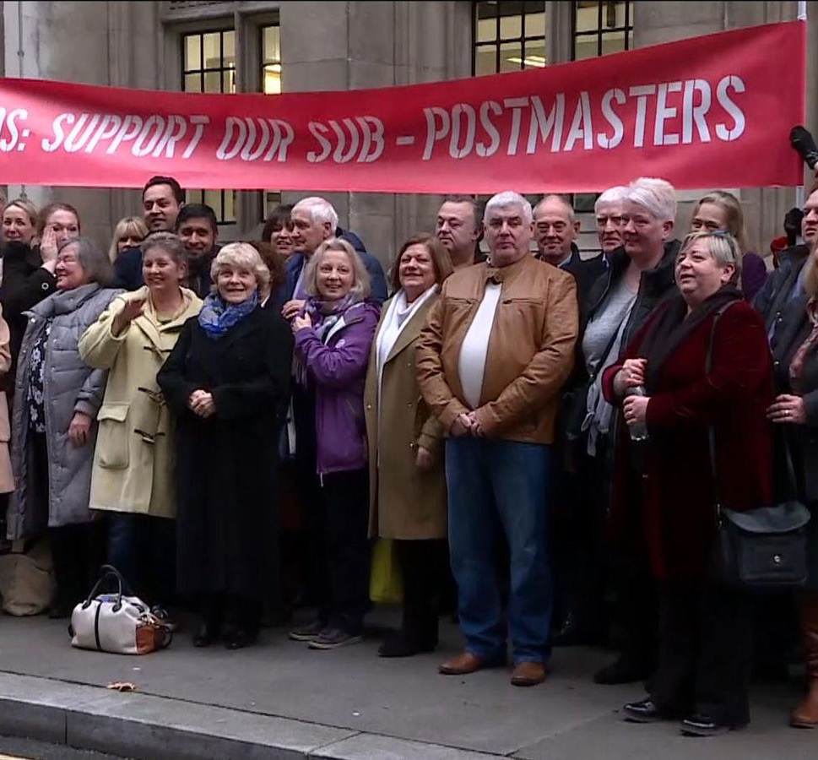
INDEPENDENCE
CPR Part 35 Practice Direction – independence
Activity objectively as an individual
Conflicts of interest in potential bias
Lawler communication might INTERFERE (Moore v Getahun 2015 ONCA 55 (CA))
Admissibility and avoiding opinions on materials issues of person.
BY Dr KAY LINNELL FCA MBA FCI Arb CFE FEWI

Slide 19
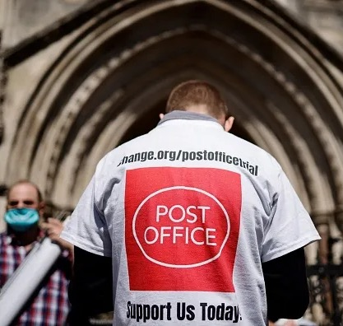
ADMISSABILITY
Relevance
Necessity
Absence of an exclusion rule
Properly qualified expert
White Burgess Langille Inman v Abbott and Halburton Co. 2015 SCC 23 (CANT II) 2015 25 CR c82 (Supreme Court of Canada)
Judge balance potential risks and benefits against prejudice, confusion and time (R v. Mohan (1994) 2SCR 9)
BY Dr KAY LINNELL FCA MBA FCI Arb CFE FEWI

Slide 20
Thank you Q&A NIFA Forensic Accountancy Conference 21st. November 2024
BY Dr KAY LINNELL FCA MBA FCI Arb CFE FEWI

