Slide 1
How do we start to do this better
Can our professions help each other to improve outcomes for clients?

Slide 2
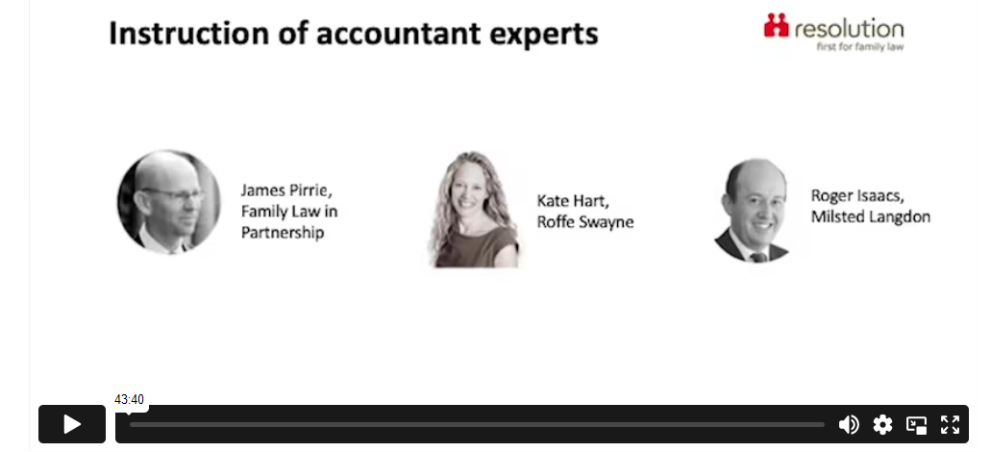

Notes:
https://resolution.org.uk/instructing-accountant-experts/

Slide 3
The path of process choices

Slide 4
Different approaches
– a schism to keep in mind as we progress.
Court based
  Hurdles – often about reducing costs / managing delay and containing court days
Arbitration
  Arbitrator will usually do what the parties agree
  Will use FPR as backdrop
  But hurdles much easier to manage
DR based
  Significantly more relaxed
  In mediation we will do what the parties need from us
  The design of the process up for grabs – the SJE will be integrated into the process
  Reports may be given verbally etc

Slide 5

Guidance & materials
Part 25 and the related PDs
Directions order
Time to time Memorandums
The instructions
Caselaw / CPR
  [ Muyepa v MOD [2022] EWHC 2648 (KB) ]
Articles
Direction from the court
(page 1) Part 25 and the related PDs … (Page 26) summary chronology
(p31) Enquiry letter
(p47) D11 application
(p56) Directions order
(p61) Instructions letter
(p66) McFarlane on experts
(p69) GA v EL
(p86) Nick Allen article
(p90)Resolution guidance
(p114) Discussion points

Slide 6
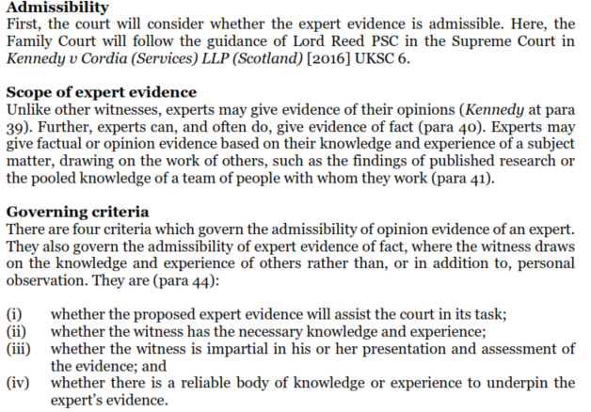
What is and what is not an expert’s question?
That is the question
(quoted McFarlane memo)

Slide 7
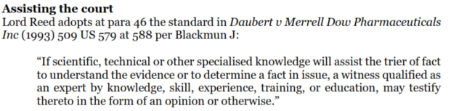
(i) Will it actually assist the court?

Slide 8
(iii) Impartiality and Zuber Bux
Impartiality requires there to be no conflict of interest: ‘expert evidence should be and should be seen to be the independent product of the expert uninfluenced as to form or content by the exigencies of litigation. Kennedy v Cordia (Services) LLP (Scotland) [2016] UKSC 6 @52(1) … now over to Mostyn J in Zuber – Bux:
Conflicts can be 1) financial 2) a conflicting duty 3) a personal connection
It includes ‘where you have been professionally or personally involved with one of the people involved in the case in the past or you have a personal interest in the case’ – GMC Guidance on acting as a witness in legal proceedings (at para 31).
Conflict types are 1) actual 2) capable 3) potential
Where ‘the solicitor had taken the expert to Wimbledon for the day with full hospitality. That largesse would not mean that a state of actual conflict of interest existed between the solicitor and the expert. However, there would be a potential conflict of interest which would need to be disclosed.’ (at para 28)
Where an expert has an interest of one kind or another in the outcome of the case, this fact should be made known to the Court as soon as possible. The question of whether the proposed expert should be permitted to give evidence should then be determined in the course of case management.’ (at para 33)
it is for the court and not the parties to decide whether a conflict of interest is material or not.’ (para 35) And later (at para 37), quoting Irwin LJ, ‘Our adversarial system depends heavily on the independence of expert witnesses, on the primacy of their duty to the Court over any other loyalty or obligation, and on the rigour with which experts make known any associations or loyalties which might give rise to a conflict.’
Zuber Bux v GMC [2021] EWHC 762

Slide 9
The selection process
[aka solicitors in a right tizzy!]
Many disorganised lawyers are trying to manage a lot - so let’s just hold that in mind.
What is clear (in my view) is:
Lawyers need to identify the need pre form E delivery
They need to precedentise up
Anything you can do to make their lives easier is gold-dust
They probably need to issue anyway [prior to identifying their expert]
The probably need their established SJEs
They need to be efficient in knowing what those guys want.

Slide 10
NIFA ‘nitiative?
Could NIFA not move itself forward by generating the standard enquiry
First we would get away from all that nonsense of names [we could quote why this was reasonable and must be done]
Secondly you could lay down the information that you have to have
Thirdly you could get the parties to focus on the question that is being raised [you could even put on the website standard questions?]
You could take control of the process a bit eg
  Refining the question
  When to be notified
  Budget
What of standard NIFA tobs from you with [key box on front re
Who is liable for fees
What is the rate
What is the likely sum
When is it due
When does interest start
You could also add in
This is what we expect from you in terms of the timeframe
You could build in a discussion point

Slide 11
GDPR – conflict checks and caution
This is the question about whether you should demand full information about personal and corporate identities.
In my view yes … Data Protection Act 2018 schedule 9 permits the processing of data that is necessary a) for the administration of justice; or b) for the 3rd party [how can you proceed without conflict checks].
Sched 10 permits processing in connection with legal proceedings, to get advice or to exercise or defend legal rights.

Slide 12
Necessity
FPR r25.4( 3) The court may give permission as mentioned in paragraph (2) only if the court is of the opinion that the expert evidence is necessary to assist the court to resolve the proceedings.
25.5 (2) When deciding whether to give permission as mentioned in rule 25.4(1) in proceedings other than children proceedings, the court is to have regard in particular to –
(a) the issues to which the expert evidence would relate;
(b) the questions which the court would require the expert to answer;
(c) the impact which giving permission would be likely to have on the timetable, duration and conduct of the proceedings;
(d) any failure to comply with rule 25.6 or any direction of the court about expert evidence; and
e) the cost of the expert evidence.
There may be occasions where covering these aspects in your responses to enquiries may be very helpful.
[Accepting too that often you may not know]
Sir James Munby P in Re: H L (A Child) [2013] EWCA Civ 655 defined "necessary" as: "Lying somewhere between 'indispensable' on the one hand and 'useful', 'reasonable' or 'desirable' on the other hand", having "the connotation of the imperative, what is demanded rather than what is merely optional or reasonable or desirable". Although those were children proceedings, I regard his dicta as equally applicable to financial remedy proceedings. [per Peel J GA v EL 2023 EWFC 187

Slide 13
Cost capping
Loggie v Loggie [2022] EWFC 2
“The moral of this unhappy tale is that the parties must ensure that the court is asked, prior to the instruction of a SJE, to place a cap on the expert's costs pursuant to FPR rule 25(12)(5).
“Prior to the court making an order for the instruction of an SJE, there will have been preliminary enquiries raised with the proposed expert and responses given thereto. By virtue of PD 25D para 3.4, incorporating PD 25B para 8.1(e), the expert will have stated his/her costs, including hourly or other charging rates, and the likely hours to be spent conducting interviews, writing the report and attending court.
“The court will thereby be fully equipped to be in a position fairly to consider these figures and to impose a cap on the expert's costs. Of course, should circumstances unexpectedly change causing far more work to be done by the expert, then it will be open for the expert to apply for the order imposing the cap to be varied under FPR r 4.1(6).”

Slide 14
Impasse – your right / duty to seek court direction [and up the budget!]
See FPR 25.17
(1) Experts may file written requests for directions for the purpose of assisting them in carrying out their functions.
(2) Experts must, unless the court directs otherwise, provide copies of the proposed requests for directions under paragraph (1) –
(a) to the party instructing them, at least 7 days before they file the requests; and
(b) to all other parties, at least 4 days before they file them.
(3) The court, when it gives directions, may also direct that a party be served with a copy of the directions.

Slide 15
The report
Business owner’s notional income Should we have input on that? What is income and what is double dipping
Can I have help on valuation You are sort of telling me what it is likely it could sell for - But shouldn’t we be asking a different question? What resources will this marriage-generated thing create during the period ahead?
I have one at the moment where a failure to see what I need - in effect report says “if the director’s loan is repaid then its value is £x But there is no money to repay that loan so how does this begin to be helpful
And note latest comments in GA v EL on Historic valuations - chill: they are not the be all and the end all - caution: the further back you go the more inaccurate they will be - control: the court not the expert decides pre and post marital wealth

Slide 16
Daniels v Walker [appointing 2nd expert] update
The post FPR 2010 law per Peel J in GA vEL 2023
i) The party seeking to adduce expert evidence of their own, notwithstanding the fact that a single joint expert has already reported, must advance reasons which are not fanciful for doing so.
ii) It will then be for the court to decide, in the exercise of its discretion, whether to permit the party to adduce such further evidence.
iii) When considering whether to permit the application, the following non-exhaustive list of factors adumbrated in Cosgrove & Anor v Pattison (supra) may fall for consideration:
"... although it would be wrong to pretend that this is an exhaustive list, the factors to be taken into account when considering an application to permit a further expert to be called are these. First, the nature of the issue or issues; secondly, the number of issues between the parties; thirdly, the reason the new expert is wanted; fourthly, the amount at stake and, if it is not purely money, the nature of the issues at stake and their importance; fifthly, the effect of permitting one party to call further expert evidence on the conduct of the trial; sixthly, the delay, if any, in making the application; seventhly, any delay that the instructing and calling of the new expert will cause; eighthly, any special features of the case; and finally, and in a sense all embracing, the overall justice to the parties in the context of the litigation'.
iv) For my own part, I would draw particular attention to the words "the overall justice to the parties in the context of the litigation" which seems to me to encapsulate neatly the court's task.

Slide 17
The role of the lawyer
In respect of what issues was permission given? Does the report answer those questions? Does it stray beyond them?
Are those opinions within the expertise of this expert? Have they shown the basis upon which their conclusions were reached? Is it objective or more conjectural?
What lacunae are left – are they appropriately covered? Are there other facts that have not been properly addressed and that might have led to other conclusions?
Has the duty under PD25B para 9 (to indicate the range of opinions where appropriate) been discharged?
Is the report signed and with the appropriate statements and does it otherwise comply with the rules (many of the core elements are in para 9.1 of PD25B)?

Slide 18
Questions on your report
See FPR 25.10 and Deputy High Court Judge NicholasAllen’s pithy article in the Financial Remedies Journal of 19 May 2022
questions are for clarification, are asked once only and should be proportionate;
they should not require an expert to carry out new investigations or expand significantly on the expert’s report; and
they are not to form cross-examination by post without court permission.

Slide 19
Keep the discussions open
All of these pinch points would be so much less likely to rub if we were having more 3-way discussions
See possible agenda points document
What’s missing?

