Slide 1
Fraud: CURRENT TRENDS &
HOT TOPICS
Arun Chauhan
30 November 2023
www.tenetlaw.co.uk

Slide 2
OVERVIEW
Setting the scene
Is any sector immune to fraud?
Corporate liability & topics of interest
Stories….investigations and disputes
Why do people break the rules? Investigations
Root cause analysis & organisational and people controls
Risks of failing controls and the role for forensic accountants
Assessing risk and building good practice
Conclusions

Slide 3
Setting the scene
Fraud is indiscriminate – organisations of all sizes impacted
Current working world has brought about an intensity of work that creates risk e.g., speed and volume of communications
Corporate criminal liability is ramping up
For employers, their need for human curiosity / professional boundaries amongst their employees can slip or not take place
Even the best compliance policies leave gaps in controls which suppliers or employees can expose
Hearing about a fraud event and living through it are very different

Slide 4
Setting the scene
The UK lost as much as £4 billion (HoL report November 2022)
Annual Fraud Indicator 2023 (Crowe) – Private sector loss to fraud £157.8bn / Public sector £50.2bn
41% plus of all crime is fraud and cybercrime – less than 1% policing budget dedicated to economic crime
47% of companies experienced fraud in the past 24 months
Fraudulent conduct 17% higher than the same period of 2021 and 11% higher than pre-pandemic levels.
Cost of living and home working is driving change of behaviours
Volume of emails and pace people operate contributing to the increase in cybercrime / mistakes / concealment

Slide 5
FRAUDSTERS – FLEXIBILITY AND APPROACH
Digitalisation has created a playground for fraudsters
English speaking countries are easier targets for digital fraud
Proximity of bad actors and their victims
Personal identity data is now the target as it allows for multiple fraud events on a business
Dishonest people and criminals find the gaps and can move quickly compared to those trying to prevent fraud
Good people can do bad things – not all fraudsters are career criminals – beware

Slide 6
EVOLVING FRAUD TRENDS AND THREATS THROUGH TECH
Retailer asked for training on new threats
Artificial intelligence – benefit and risks
Generative AI – the threats (automation of reviews / fake review farms)
Chat GPT utilisation to generate fake reviews
Role of social media in facilitating fraud and counterfeit operations
Phishing and influencer scams in practice
Notes:
card testing attacks, where fraudsters can test thousands of stolen cards on a retailer's platform through automated scripts, all in a matter of seconds
https://fortune.com/2023/08/14/amazon-fake-reviews-problem-generative-ai-summaries-andy-jassy/

Slide 7
Is any sector immune from fraud?
Example of Lawyers & Accountants – we advise about risk – what about our own risk?
For law firms, compliance risk with respect to the SRA and outcomes focused regulation – requires corporate maturity
Pressures presently on professional service firms (salaries, overheads, employees, cyber, competency, pace of work, location of work, PII, etc.)
Ecosystem of a firms (people, IT, physical assets, data of others, money transactions, targets, culture) – all attractive to fraudsters to expose
Remember 41% of all crime is fraud / cybercrime
Human curiosity / professional boundaries can slip or not happen when under pressure
All sectors have a complex eco-system of risks against a climate of increased fraud
No sector is immune

Slide 8
Corporate liability landscape
UK Government approach to fraud and financial crime
Economic Crime & Transparency Act 2023 – Failure to Prevent offence
Digital Markets, Competition and Consumers Bill
Online Safety Act
POCA / MLR / BA 2010 / CFA 2017

Slide 9
Topics of interest this year
Employee fraud and bribery investigations (various)
Commercial fraud awareness (various)
Enterprise-wide fraud risk assessment – (financial services UK and ME)
Cyber threats to business (various)
Public sector fraud
Civil court orders – assistance for investigations (investigators)
Wirecard - $28bn to nothing (internal auditors conference)
Managing fraud and corruption litigation in England & Wales (US corporate audience)
Fraud risk for law firms (e.g. collapse of Axiom Ince £60m + missing)
Notes:
• Wirecard founded in 1999, Wirecard went from a payment-processing company for porn and online gambling to a tech company that was, at one point, worth $28bn.
• Thanks to the Financial Times’ courageous reporting, in particular Dan McCrum, the truth was finally revealed and Wirecard crashed into insolvency in June 2020.
• Four lines of defence failed – company’s internal control system, its supervisory board, the financial regulator (BaFin in Germany) and external audit
• In June 2020 when EY (WireCard’s auditor) said it had been provided false information, could not sign off on the company’s 2019 accounts, and could not confirm whether two billions dollars (¼ of the balance sheet) even existed.
• EY produced a clean audit for Wirecard’s financials from 2009 to 2018.
• As revealed by KPMG's special audit, Wirecard's long time auditor EY failed to verify the existence of cash reserves in what appeared to be fraudulent bank statements.
• EY’s worldwide chairman, expressed regret that fraud at Wirecard had gone undetected and promised clients that the company would “raise the bar” to improve its standards.
All about roundtripping - Round tripping occurs when one company sells assets to another party in order to generate sales, and later buys back the assets.

Slide 10
Stories . . . Investigations
Education procurement case – analysis of accounts to identify misleading implied statements as to financial stature
Employee misappropriation – architects practice
Supplier preference – housing association

Slide 11
Stories . . . Disputes
Shareholder dispute – misappropriation and valuation
Investment into SME coaching business – fraudulent misrepresentation
Private equity acquisition – alleged loss from conspiracy

Slide 12
Why do people break the rules? Investigations
Investigations – identifying the root cause
Why are stories of employee fraud increasingly common?
Humans – we take risks depending on our circumstances
Fraud is not black and white
Senior exec’s moral compass – what we expect of others?
Moral fatigue – good people can do bad things
Dishonest actions can be seen as sharp practice
Traditional understanding of why employees commit fraud
The modern workplace and impact of culture and wellbeing on fraud
Notes:
Restaurant question

Slide 13
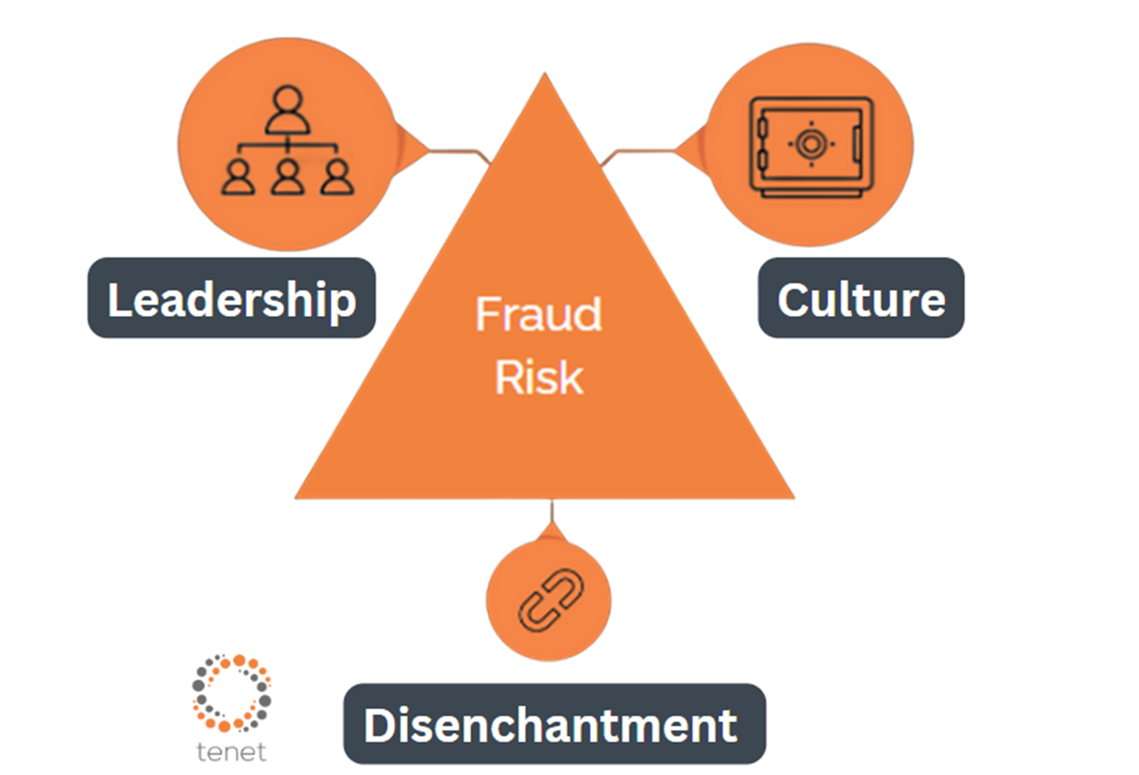
ALTERNATIVE FRAUD TRIANGLE
Notes:
Right thing for me not the right thing

Slide 15
Root cause analysis
Policies not followed or not practicable
Poor technology
Due diligence on suppliers, employees and clients
Lack of regular and meaningful staff training
Fraud – how is it defined?
Culture

Slide 16
REACTIONS – CHALLENGING THE BELIEF
Anything which is growing unusually quickly needs to be checked out, and it needs to be checked out in a way that it hasn’t been checked before”
(Dan Davies – Lying for Money)
….if you do not understand, ask questions”
(Me and many others!!)

Slide 17
Organisational and people controls
Segregation of duties
Approval processes
Internal audits
Budgeting
Declarations of interest
Access restrictions / controls for remote working
Enforced annual leave
Monitoring IT usage
Fraud response planning
A new one for me – normal distribution with fake numbers
Notes:
Benford’s law
Based on the plausible assumption that people who fabricate figures tend to distribute their digits fairly uniformly, a simple comparison of first-digit ...

Slide 18
Risks if controls are not fit for purpose – preventative role for forensic accountants?
Reputation
Regulatory sanctions / fines
Business interruption
Morale reduction, restructuring and retraining
Remedial costs
Impact on insurance premiums
Impact on expansion plans

Slide 19
Assessing exposure to risk of fraud
Do businesses have the right policies and procedures in place?
When were these reviewed?
Are these policies and procedures accessible and easily understood by your colleagues?
Have economic challenges been considered?
Do businesses take operational teams’ input when building fraud controls?
Do businesses know how you would react to different types of fraud?
Is there confidence in your whistleblowing function?

Slide 20
Building good practice
Buy in – building polices from the ground up - ownership
Make fraud a frequent agenda item at all levels – people need to understand where to find guidance and understand the subject
Internally publicise your actions on combatting fraud
Contract terms (suppliers and employees) need to cover fraud issues
Know your response to fraud types before you take action
Training on what to look for, how to monitor, how to respond
Whistleblowing - understand the process and give external parties the chance to engage (on risks and not just bad behaviour)
Policies and procedures that work for your firm
Notes:
Fraud education is a two way conversation

Slide 21
Conclusions
Fraud is not black and white, conduct and actions can be interpreted by people in different ways dependent on circumstances
Economy now will drive ‘sharp’ and on occasions, dishonest practice
The impact may be low financially, but impact is wide ranging as control environment is a key focus for all regulators – controls not just about testing policies / procedures
Understanding the steps and planning to take if you need to investigate fraud is vital before the event happens – having forensic accountants involved early is key
Do not let clients find that they have a gap analysis after the event with your policies which show a systemic failing of controls – review policies, procedures and training regularly to make sure it is fit for purpose
Overall, fraud is on the increase and it is a vibrant area for new work

Slide 22
WHY TENET?
We believe education is pivotal in the fight against fraud. It is important for us as a firm to offer knowledge, best practice and information to help reduce the risk of fraud, not just for our clients but for everyone.
We make it simple, keeping calm and providing clear, actionable advice at a time of uncertainty and high risk.
If we had an impossible ambition, it would be to stop fraud. Its impact is wide ranging and that is why we focus solely on this area of law.
Our strengths lie in the way we operate, with no financial, chargeable hours or cash collection targets for our lawyers.
Our team have all had at least five years of experience in a national or international law firm. They are encouraged to focus on the client, delivering high-quality services, from the locations, and within the hours, that suit them. Flexibility has been part of our culture from day one.
tenetlaw.co.uk

Slide 23
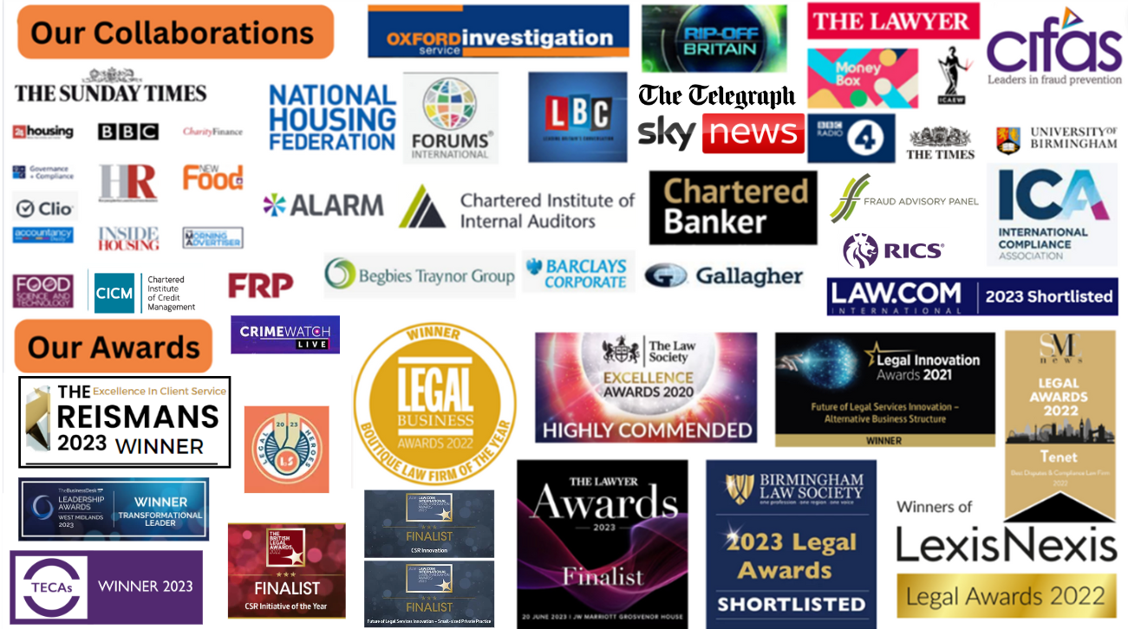

Slide 24
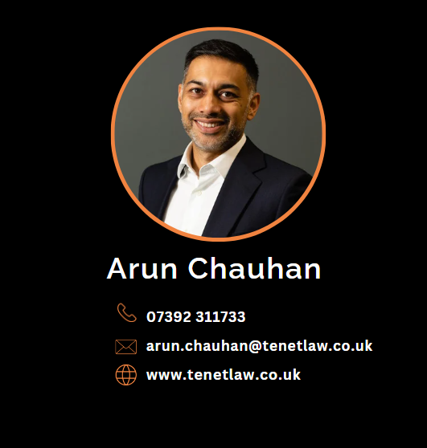
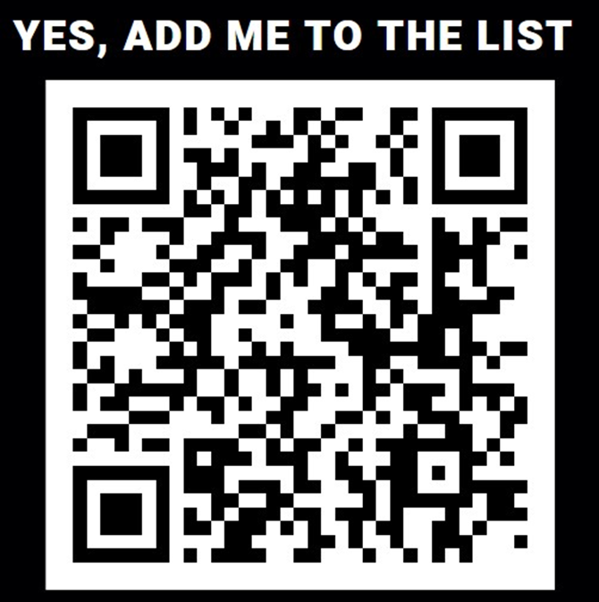
Thank you!
Notes:
UPDATE PHOTO

