Slide 1
Business Valuation
21 November 2024

Slide 2
Valuation: practical problems
Andrew Strickland
Business Valuation
Some Practical Problems
Growth Shares

Slide 3
Valuation: practical problems
What is goodwill?
Treatment of Overdue tax
Valuing Voting Shares
Deferred consideration and value
International Valuation Standards
Shareholder Disputes
Growth shares

Slide 4
Valuation: practical problems
Valuing Goodwill
Direct Valuation:
Insurance brokers
Accountants
Independent financial advisers
Pharmacists
Some other retail sectors

Slide 5
Valuation: practical problems
Profits after tax £200,000
Net assets £1,400,000
Goodwill?

Slide 6
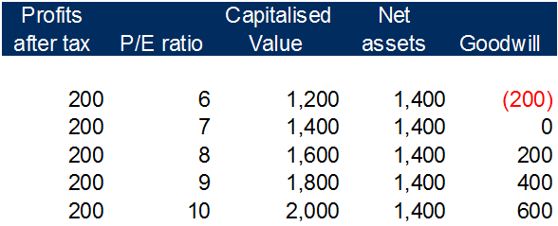
Valuation: practical problems
Profits after tax £200,000
Net assets £1,400,000
Goodwill?

Slide 7
What is Goodwill?
Enterprise value
Normalised operating profits | 110,000
Post tax | 82,500
Capitalisation rate | 12.5%
Enterprise value | 660,000
Net operating assets | 327,416
Intangible assets | 332,584
Enterprise to Equity Bridge
Enterprise value | 660,000
Investments | 94,840
Related company loan | 564,930
Cash less corporation tax | 636,740
Equity value | 1,956,510
Net Shareholders' funds | 1,623,926
Intangible assets | 332,584
Valuation: practical problems

Slide 8
What is negative goodwill?
Net Asset Value is not a Floor to Value
Enterprise Value
Normalised operating profits | 110,000
Post tax | 82,500
Capitalisation rate | 12.5%
Enterprise value | 660,000
Net operating assets | 723,416
Negative goodwill | (63,416)

Slide 9
Debt-like and cash-like
Debt and Debt-like Balances
Conventional borrowings
Overdue tax
Shareholder/director loans to company
Funding loans from related companies
Cash and Cash-like Balances
Surplus cash (cash less Corporation tax?)
Funding loans to related companies
Overdrawn directors’ loan accounts
Section 455 Tax assets

Slide 10
Voting shares
Voting rights
US paired studies – 2% discount for non-voting minority shares
View of HMRC
“Valuation problems may arise in respect of shares with special voting rights, in other words shares of a special class carrying all the votes or a preponderant share of the votes, or voting ordinary shares where other ordinary shares are non-voting.” SVM 108200

Slide 11
Voting shares
Valuation of Voting Shares
Holt v Holt ((New Zealand) [1990] UKPC 34) LJ Holt Limited
One A share (10,000 votes) and 999 B shares (999 votes)
Last time: Ireland: voting rights equal 15% of total value

Slide 12
Voting shares
The farm: 7,000 acres
“The farm could be run at a profit or at a loss depending on the amount which the husband chose to spend on the upkeep and improvement of the farm.”

Slide 13
Voting shares
New Zealand Court: 23% of the whole
Privy Council: 50% of whole? No wish to interfere with New Zealand decision
Special features: the value of LJ Holt Limited was in reasonable remuneration and life as a country squire.
My view: 20% to 25% of the whole in other circumstances

Slide 14
Deferred consideration
IVS “market value” basis – value measured as cash on completion
Deferred consideration
Counter-party risk?
If an MBO, the risk is equity-level risk
Earn-outs

Slide 15
International valuation standards
Now IVS 2025
No major textual changes
Re-arrangement of chapters
Check references and specific text in quotes from IVS.
The importance of language: approaches, bases, methods, premises
“Three methods: Price Earnings Ratio, Dividend Yield and Net Asset Value”

Slide 16
Shareholder disputes
Section 994, Companies Act 2006
Does not normally trump arrangements agreed by shareholders:
Dr Agbaje and The Robert Frew Medical Company Limited [2022] EWHC 1373
Wells and Hornshaw [2024] (EWHC 330 (Ch)

Slide 17
Shareholder disputes
Dr Agbaje and The Robert Frew Medical Company Limited [2022] EWHC 1373
Shareholders’ Agreement
“..taking into account any restrictions on such sale or the size of the holding being sold…”

Slide 18
Shareholder disputes
Wells and Hornshaw [2024] (EWHC 330 (Ch)
Transwaste Recycling and Aggregates Limited
Mr Wells: 14.3%, two brothers 42.85% each

Slide 19
Shareholder disputes
“Here, I see nothing unfair in holding Mr Wells to the contractual framework he signed up to, to govern precisely the situation which arose, in which he wanted to leave TRAL and dispose of his minority shareholding to the remaining shareholders.”

Slide 20
Shareholder disputes
The Search for Fairness – moving beyond the Quasi-Partnership Concept
Kohli v Lit (Sunrise Radio) [2009] EWHC 2893
Murrell v Sanders and Swallow (Blue Index) [2014] EWHC 2680
McCallum-Toppin and McCallum-Toppin (AMT Coffee) [2019] EWHC 46
Estera Trust (Jersey) Ltd v Singh [2018] EWHC 1715 (Ch)

Slide 21
Growth shares
Some complex material now. Why?

Slide 22
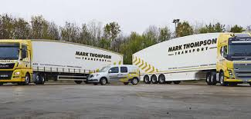
JASPRIA’s request
East River Transport Acquired Recently for £10 million
Incentives to Management Team in Growth Shares

Slide 23
Proposal for growth shares
10% of value above £11 million
10% of value above £15 million
10% of value above £20 million

Slide 24
The view of International Valuation standards 2025
IVS 2025:
“For complex capital structures that include a form of equity other than just common stock, the valuer may use any reasonable method to determine the value of equity or a particular class of equity.”
(IVS 200.130.6)

Slide 25
The view of International Valuation standards 2025
Current Value Method “CVM”
Option Pricing Method “OPM”
Probability-Weighted Expected Return Method “PWERM”

Slide 26
Growth shares
CVM: No value above £10 million
“A limitation of the CVM is that it is not forward looking and fails to consider the option-like payoffs of many share classes.” (IVS 200.130.10)

Slide 27
Different payoffs
“…option-like payoffs…”
An absence of symmetry
Call options in the market

Slide 28
Growth shares
Share
Share Price of £10
Call
Call option to purchase at £11 in 6 years’ time
Value
Value of call is £2.955
(option with volatility of 30%, no dividends)

Slide 29
Growth shares
Only use CVM if:
Liquidity event imminent;
Early stage – no value above the liquidation preference;
No significant progress with business plan
No reasonable estimating basis exists

Slide 30
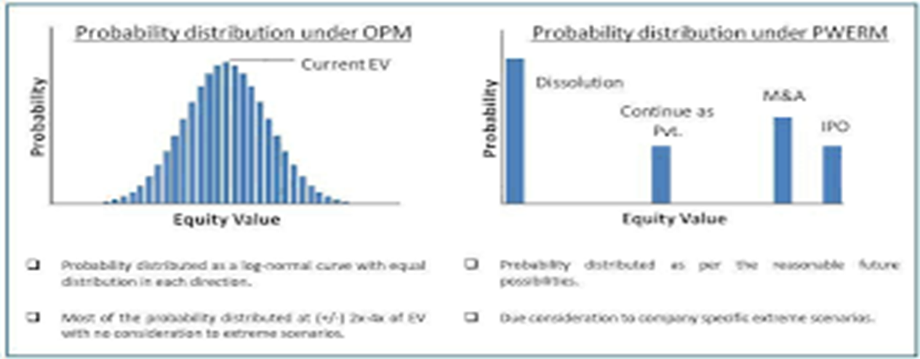
Growth shares
Probability-Weighted Expected Return Method (PWERM)

Slide 31
Growth shares

Slide 32
Growth shares
Options are a tool for different purposes:
Calculating the DLOM
Allocation of values over complex share classes
For determining value of one class of equity, based on the value of another
Valuation of shares which do not participate at the current value - cheap stocks (USA) and growth stocks (UK and Europe)
Valuation of convertible loans

Slide 33
Growth shares
The Language of Options
An option is a choice:
A call option is a right to buy at a set price in the future
A put option is a right to sell at a set price in the future

Slide 34
Growth shares
Inputs into Black Scholes
The stock price – S
The strike price – K
Risk-free rate – r
Volatility of underlying stock – the Greek letter sigma (“σ”)
Rate of continuously compounded dividend – q
An option is a derivative – value derived from another instrument. That instrument is known as “the underlying ”.
Time period to exercise – t

Slide 35
Growth shares
Conditional Probability and Probability
$$\left(S x conditional probability\right) less \left(K x probability\right)$$
Conditional Probability?
It gives the value of the share at the end of the option period if, but only if, the share price S is greater than the strike price K.
All values below the strike price are discarded

Slide 36
Growth shares
Conditional Probability:

Slide 37
Growth shares
The Binomial Lattice:
Used for valuation of American Options (if company is paying dividends) and for convertible loan notes
A glimpse into the inner workings of BSOPM
Start with share price
Price moves up or down on each step
In the example there are ten steps

Slide 38
The binomial model: two paths
 |  |  |  |  |  |  |  |  |  | End values | Probability
 |  |  |  |  |  |  |  |  |  | 102.14 | 1/1024 | 0.098%
 |  |  |  |  |  |  |  |  | 80.96
 |  |  |  |  |  |  |  | 64.18 |  | 64.18 | 10/1024 | 0.977%
 |  |  |  |  |  |  | 50.87 |  | 50.87
 |  |  |  |  |  | 40.32 |  | 40.32 |  | 40.32 | 45/1024 | 4.395%
 |  |  |  |  | 31.96 |  | 31.96 |  | 31.96
 |  |  |  | 25.33 |  | 25.33 |  | 25.33 |  | 25.33 | 120/1024 | 11.719%
 |  |  | 20.08 |  | 20.08 |  | 20.08 |  | 20.08
 |  | 15.92 |  | 15.92 |  | 15.92 |  | 15.92 |  | 15.92 | 210/1024 | 20.508%
 | 12.62 |  | 12.62 |  | 12.62 |  | 12.62 |  | 12.62
10.00 |  | 10.00 |  | 10.00 |  | 10.00 |  | 10.00 |  | 10.00 | 252/1024 | 24.609%
 | 7.93 |  | 7.93 |  | 7.93 |  | 7.93 |  | 7.93
 |  | 6.28 |  | 6.28 |  | 6.28 |  | 6.28 |  | 6.28 | 210/1024 | 20.508%
 |  |  | 4.98 |  | 4.98 |  | 4.98 |  | 4.98
 |  |  |  | 3.95 |  | 3.95 |  | 3.95 |  | 3.95 | 120/1024 | 11.719%
 |  |  |  |  | 3.13 |  | 3.13 |  | 3.13
 |  |  |  |  |  | 2.48 |  | 2.48 |  | 2.48 | 45/1024 | 4.395%
 |  |  |  |  |  |  | 1.97 |  | 1.97
 |  |  |  |  |  |  |  | 1.56 |  | 1.56 | 10/1024 | 0.977%
 |  |  |  |  |  |  |  |  | 1.24
 |  |  |  |  |  |  |  |  |  | 0.98 | 1/1024 | 0.098%

Slide 39
The binomial model: 672 paths
 |  |  |  |  |  |  |  |  |  | End values | Probability
 |  |  |  |  |  |  |  |  |  | 102.14 | 1/1024 | 0.098%
 |  |  |  |  |  |  |  |  | 80.96
 |  |  |  |  |  |  |  | 64.18 |  | 64.18 | 10/1024 | 0.977%
 |  |  |  |  |  |  | 50.87 |  | 50.87
 |  |  |  |  |  | 40.32 |  | 40.32 |  | 40.32 | 45/1024 | 4.395%
 |  |  |  |  | 31.96 |  | 31.96 |  | 31.96
 |  |  |  | 25.33 |  | 25.33 |  | 25.33 |  | 25.33 | 120/1024 | 11.719%
 |  |  | 20.08 |  | 20.08 |  | 20.08 |  | 20.08
 |  | 15.92 |  | 15.92 |  | 15.92 |  | 15.92 |  | 15.92 | 210/1024 | 20.508%
 | 12.62 |  | 12.62 |  | 12.62 |  | 12.62 |  | 12.62
10.00 |  | 10.00 |  | 10.00 |  | 10.00 |  | 10.00 |  | 10.00 | 252/1024 | 24.609%
 | 7.93 |  | 7.93 |  | 7.93 |  | 7.93 |  | 7.93
 |  | 6.28 |  | 6.28 |  | 6.28 |  | 6.28 |  | 6.28 | 210/1024 | 20.508%
 |  |  | 4.98 |  | 4.98 |  | 4.98 |  | 4.98
 |  |  |  | 3.95 |  | 3.95 |  | 3.95 |  | 3.95 | 120/1024 | 11.719%
 |  |  |  |  | 3.13 |  | 3.13 |  | 3.13
 |  |  |  |  |  | 2.48 |  | 2.48 |  | 2.48 | 45/1024 | 4.395%
 |  |  |  |  |  |  | 1.97 |  | 1.97
 |  |  |  |  |  |  |  | 1.56 |  | 1.56 | 10/1024 | 0.977%
 |  |  |  |  |  |  |  |  | 1.24
 |  |  |  |  |  |  |  |  |  | 0.98 | 1/1024 | 0.098%

Slide 40
The binomial model

Slide 41
Binomial model formulae
Working left to right:
$Up factor= e^{(σ.\sqrt{\frac{t}{n}})}$
$Down factor= \frac{1}{Up factor}$
e = exponential number 2.71828…
σ = sigma = volatility
t = time period in years
n = number of steps in binomial expansion
r = risk-free rate of interest for period t

Slide 42
Binomial model formulae
Working right to left
$P= \frac{e^{(r.\frac{t}{n} ) − Down factor}}{Up factor−Down factor}$
$Combined factor=\left(\left(P x option up\right)+\left(\left(1−P\right)x option down\right)\right)x e^{\left(−r.\frac{t}{n}\right)}$

Slide 43
Growth shares
Comparing Black Scholes with Binomial Lattice:
Black Scholes £2,955,000
Binomial Model (10 steps): £2,970,000
99.5%
What is the difference?
Black Scholes – an infinite number of value points
Binomial Model – 11 value points

Slide 44
Growth shares
Theoretical Underpinnings
A model for options on shares in listed companies
No equity growth factor in the model
The concept of dynamic hedging

Slide 45
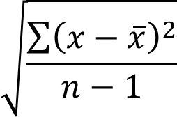
Growth shares
Volatility
“The measure of volatility used in option pricing models is the annualised standard deviation of the continuously compounded rates of return on the share over a period of time.” (IFRS 2, Appendix B)
“continuously compounded” = log natural (later price/earlier price)
“standard deviation”

Slide 46
Annual Volatility: the text book approach
Assess the volatility of guideline public companies
If using daily data, multiply by the square root of 252 = 15.9
If using weekly data, multiply by the square root of 52 = 7.2
If using monthly data, multiply by the square root of 12 = 3.5

Slide 47
Growth shares

Slide 48
Growth shares
Sources of Volatility Data
Guideline Public Company Method; or
“If the entity has not based its estimate of the value of its shares on the share prices of similar listed entities, and has instead used another valuation methodology to value its shares, the entity could derive an estimate of expected volatility consistent with that valuation methodology. For example, the entity might value its shares on a net asset or earnings basis. It could consider the expected volatility of those net asset values or earnings.” (IFRS 2)

Slide 49
Black scholes – the bare bones
$$S x N\left(d_{1}\right)−N\left(d_{2}\right) x Ke^{−rt}$$
$$\left(S×conditional probability)−(Ke^{−rt} ×probability\right)$$

Slide 50
Continuous discounting
In excel: EXP(-rt)
Scientific calculators Ln button
$$e^{−rt}$$
Discounts the strike price back to the start of the option (the valuation point)

Slide 51
Growth shares
$$d_{1}=\frac{ln\left(\frac{S}{K}\right){+ \left(r+ \frac{σ^{2}}{2}\right)t}}{σ.\sqrt{t}}$$
$$d_{2}=\frac{ln\left(\frac{S}{K}\right){+ \left(r− \frac{σ^{2}}{2}\right)t}}{σ.\sqrt{t}}$$

Slide 52
Growth shares
Shares and Assets Valuation of HMRC:
Risk and Reward
Not Prescriptive About Methods
Address forward looking aspect of valuation
Would existing shareholders give the rights away?

Slide 53
Growth shares
If you have been……..
Thanks for listening!

