Slide 1
Discounted cash flow methodology in valuation
Presentation at NIFA Conference
Alison Barnes, 21 November 2024

Slide 2
Contents
1. Key themes for today’s presentation
²
12. DCF example – with terminal growth
¹⁶
2. Value is a forward-looking concept
³
^{13. Good practice in DCF}
¹⁷
^{3. What the IVSC says}
⁵
14. Some pros and cons of using DCF
¹⁸
4. Valuation over business life cycle
⁷
15. But what would the multiple have been?
¹⁹
5. DCF methodology – an outline
⁸
^{16. In summary}
²¹
^{6. The time value of money}
⁹
^{Any questions?}
²²
^{7. The discount rate - WACC}
¹⁰
8. Calculating cost of equity…
¹¹
9. What about debt and gearing?
¹²
^{10. The Gordon Growth Model}
¹³
11. DCF example – no terminal growth
¹⁵

Slide 3
1. Key themes for today’s presentation
Valuation is about the future
DCF inputs – selecting and using
International Valuation Standards Council (IVSC) guidance

Slide 4
2. Value is a forward-looking concept
The value of an asset is widely referred to and accepted as equating to:
  The future economic benefit that a holder of that asset is expected to obtain from its ownership.
  Buyer is acquiring the future prospects not the past glories (or disasters)
    As an aside, why are historical earnings and multiples sometimes used in valuation?
    Might be relevant if the past indicates the future
The discounted cash flow (DCF) valuation methodology is all about the future

Slide 5
2. Value is a forward-looking concept
The IVSC uses the terminology ‘Income Approach’ for the DCF methodology
It states (my emphasis) :
“The income approach provides an indication of value by converting projected cash flows to a single current value. Under the income approach, the value of an asset is determined by reference to the value of income, cash flow or cost savings generated by the asset.”
Source: IVS 2025: 103.30.01

Slide 6
3. What the IVSC says
The income approach should be applied and given significant weight when:
  Income-producing ability is critical element affecting value; and/or
  Reasonable income forecasts are available, but no relevant or reliable comparable listed companies
Source: IVS 2025: 103.30.02

Slide 7
3. What the IVSC says
Valuer should consider whether any other approaches (my emphasis) “can be applied and weighted to corroborate the indication of value from the income approach” where:
  Income-producing ability is only one of several factors affecting value; and/or
  Forecasts are significantly uncertain; and/or
  Lack of access to forecast information (for example by a minority) but not to historical financial statements; and/or
  Entity is pre-revenue, but revenue is expected.
Source: IVS 2025: 103.30.03

Slide 8
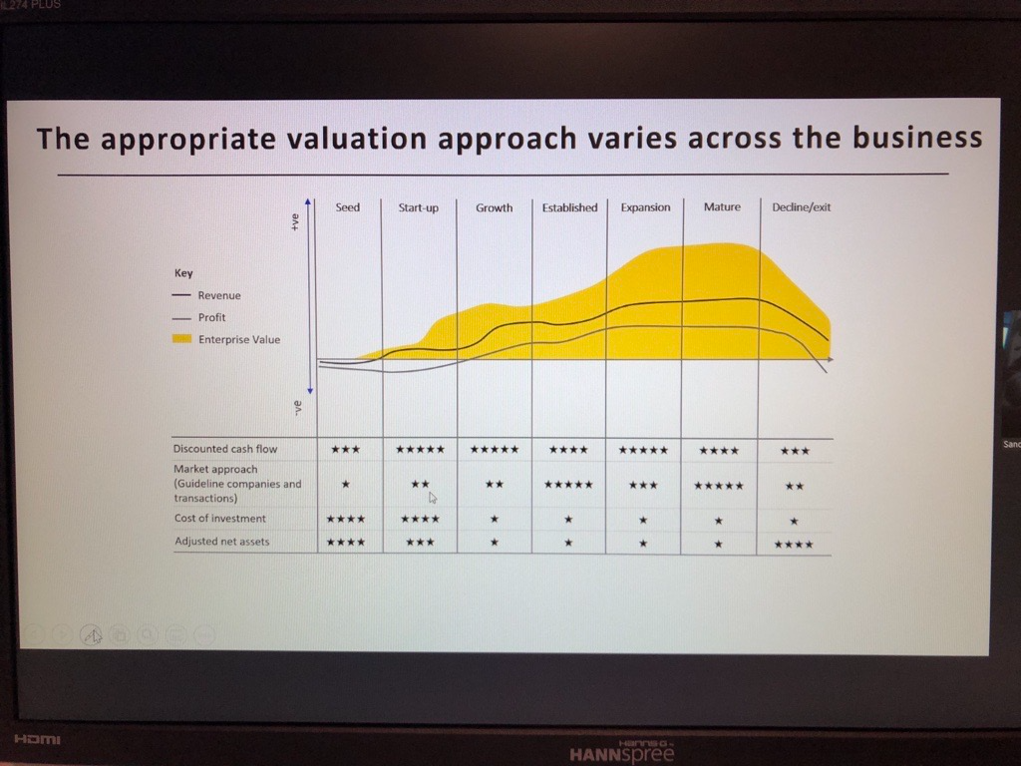
4. Valuation over business life cycle
Image from ICAEW forensic conference 2023 – session on valuation by Sandra Mossios, partner at EY and co-founder of BVB Insights

Slide 9
5. DCF methodology – an outline
Usual method is to calculate Enterprise Value (EV) by applying a suitable discount rate to forecast, free cash flows. Free cash flows are:
  After tax, capex and working capital movement estimates; but
  Before interest and financing cash flows (as debt-free, cash-free)
Discount rate usually applied is the weighted average cost of capital (WACC)
  WACC is the rate required, on average, by debt and equity holders as a return on their debt funding and/or investment

Slide 10
6. The time value of money

Slide 11
7. The discount rate - WACC
WACC = (Ke x E/C) + (Kd x D/C)
Where:
Ke = Cost of equity. Calculate using extended/modified Capital Asset Pricing Model (“CAPM”) (see next slide)
Kd = Average cost of debt capital (post tax) = marginal, market rate at which entity can borrow today
E = Market value of equity capital
D = Market value of (anticipated) debt capital
C = Total market value of debt plus equity capital

Slide 12
8. Calculating cost of equity…
…using the extended/modified Capital Asset Pricing Model (CAPM) for smaller and non-listed companies
CAPM: Ke = Rf + (β * RPm)
Modified CAPM: Ke = Rf + (β * RPm) + RPs ± RPa
Where:
Ke = Cost of equity
Rf = Risk free rate
β = Equity (geared or levered) beta
RPm = Equity risk premium (“ERP”)
RPs = Size premium
RPa = Additional company specific risk premium – also known as Alpha

Slide 13
9. What about debt and gearing?
In calculating WACC, target’s current level of debt and/or gearing ratio is not necessarily relevant if not optimised or not geared in line with the market
Might consider instead:
  Market gearing structure based on comparative listed companies
  Target’s debt capacity – subject to debt limit after which risk (and cost of debt) rises
  Optimal capital structure – minimise WACC while maximising market value (Modigliani and Miller)

Slide 14
10. The Gordon Growth Model
Does growth (g) need to be factored into the terminal value?
If not, the discount factor (r) for the terminal value is 1/r
If it does, the discount factor for the terminal value is adjusted to:
  1/(r - g)
  Where:
  r = discount rate
  g = terminal growth rate

Slide 15

10. The Gordon Growth Model
Been around since 1956
All down to Professor Myron Jules Gordon, an American economist, along with his colleague Eli Shapiro, when they were at the Massachusetts Institute of Technology

Slide 16
11. DCF example – no terminal growth

Slide 17
12. DCF example – with terminal growth

Slide 18
13. Good practice in DCF
Apply a range of discount rates – say low and high
Flex to understand impact of the various inputs
Triangulation to other methods:
  IVSC comments that the valuer is not required to, but should consider the use of a number of approaches and methods
  “…particularly where there are insufficient factual or observable inputs for a single method to produce a reliable conclusion.”
  Source: IVS 2025: 103.10.05 and 103.10.06

Slide 19
14. Some pros and cons of using DCF
Pros | Cons
Intrinsic value – key to an investor | May be less familiar methodology to client or those instructing us
Not affected by accounting practices and assumptions | Quality of inputs critical
Not significantly influenced by temporary market conditions (also a ‘Con’?) | Can appear more ‘technical’ or ‘mathematical’
Theoretically the soundest method (if the valuer is confident re assumptions made) | Using without sense-checking how all the components work together
Well recognised/systemised approach | Can be significantly dependent on the ‘terminal value’ assumptions (see below)
Good where profits/cash flows are not steady state, or there are losses – therefore good for start-ups
Good cross-check to other methodologies, in particular multiple-based (market) approach
Useful when there are very limited (or, unlikely, no) listed comparator companies

Slide 20
15. But what would the multiple have been?
Simple example:
  Maintainable (terminal) cash flow = £2,000
  Discount rate = 20%
  Enterprise value (EV) = £2,000 x 1/0.2 = £2,000 x 5 = £10,000
                Inverse of discount rate = “multiple”
                Broad-brush indicative measure for free cash flow. For EBITDA?

Slide 21
15. But what would the multiple have been?
                For individual historical and prospective years, compare cash flow/EBITDA with calculated EV to derive equivalent multiples for those years
                For example:

Slide 22
16. In summary
Valuation is about the future
DCF inputs – take time to select; use sensibly; understand the sensitivity
IVSC – DCF is increasingly mainstream

Slide 23
Any questions?

Slide 24
Please note that the information contained in this presentation is provided for general informational purposes only. It does not constitute any form of tax, accounting or other professional advice, and you should not use it as a substitute for advice tailored to your specific circumstances.
We disclaim all and any liability for any actions you take (or omit to take) in reliance upon the contents of this presentation.
Philip Allsop, Tony Chapman, Alison Barnes, Emma Oakley
BHP LLP

